Slide 1
C#
C# is a High level Microsoft language supporting Object Oriented Programming
WPF
WPF (Windows Presentation Foundation) is a Microsoft technology for making Graphical User Interface applications. It is used in Desktop applications and Microsoft’s newer Universal Windows Platform (although called UWP instead of WPF its really the same)
WPF uses a mixture of C# and XAML
Created to more easily separate UI code from Business Logic. Also allows easier division for editing so a graphic designer could generate without any behind code.
Allows skinnable apps to be more easily created.
XAML
(Extensible Application Markup Language) which is XML based.
Allows editing without code behind and placing UI behavior right in the xml.

Slide 2
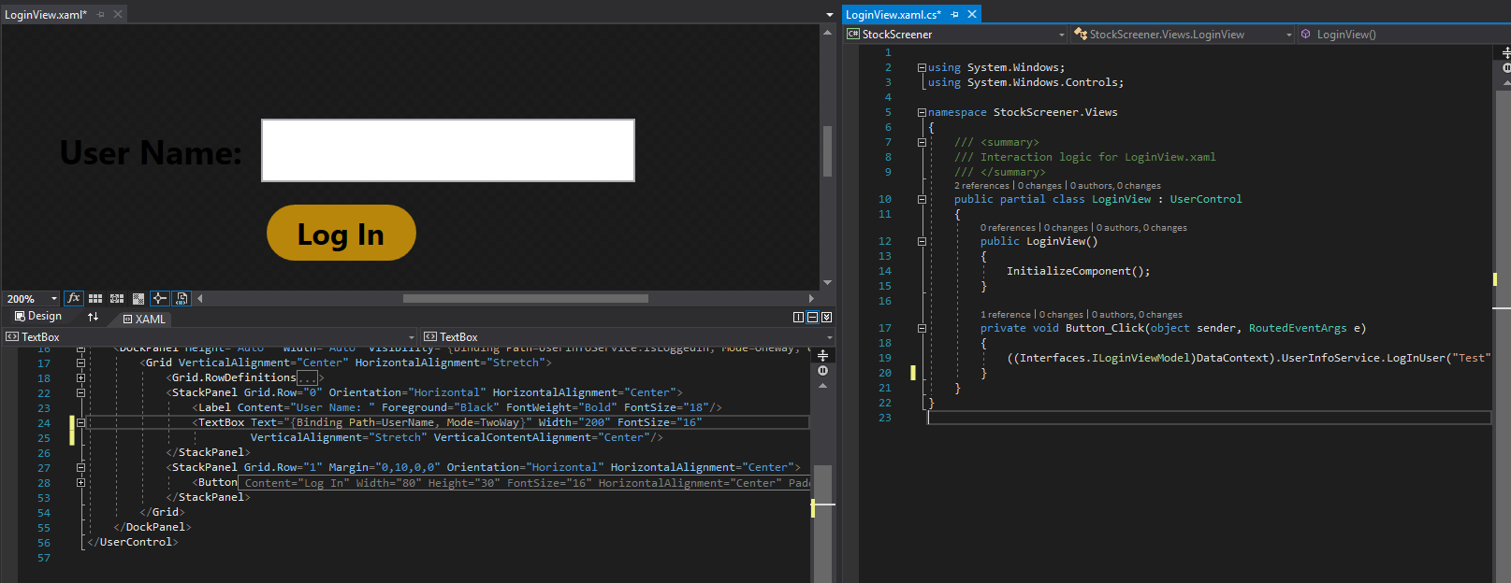
C#/WPF/XAML EXAMPLE
XAML with Designer on top
C# code behind

Slide 3
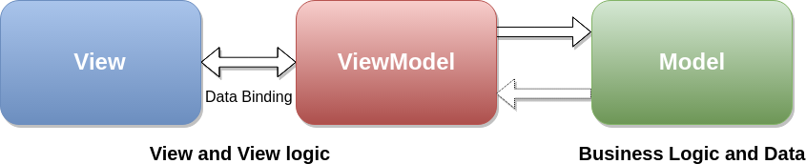
mvvm
MVVM is a design pattern called MODEL VIEW VIEW-MODEL. THERE ARE OTHER SIMILAR DESIGN PATTERNS: MVC, MVP ETC.
GOAL IS TO CREATE SEPERATED LAYERS FOR AN APPLICATION SO THE UI IS SEPERATED FROM THE BUSINESS LOGIC
WPF PLAYS PERFECT WITH THIS DESIGN THROUGH ITS ABILITY TO BIND TO PROPERTIES
THE CONCEPT IS THE VIEW (UI) REFLECTS PROPERTIES OR CALLS METHODS ON THE VIEW MODEL (IN WPF THROUGH BINDINGS). THE USER IS INTERACTING WITH THE VIEW BUT ALL CODE COMMANDS/CHANGES ARE HAPPENING IN THE VIEW MODEL.
THE VIEW MODEL’S JOB IS PROVIDE PROPERTIES OR METHODS TO SUPPORT VIEWS. IT DOES NOT ACTUALLY KNOW ANYTHING ABOUT THE VIEW THOUGH
THE MODEL (OR SERVICE) IS STRICTLY BUSINESS CODE THAT DOES NOT CARE ABOUT UI’S OR SUPPORTING THEM. THEY CAN LIVE COMPLETELY ON THEIR OWN AND KNOW NOTHING ABOUT THE VIEW MODEL OR VIEW

Slide 4
MVVM IN ACTION
Example of an Application to run an Instrument Connection UI
STUDENT
TEACHER
SCIENTIST
TECHNICIAN
VIEWS
VIEW MODEL
MODEL
SERVICE KNOWS NOTHING ABOUT THE REST.
VIEW MODEL MESSAGES THE SERVICE TO SUPPORT THE VIEWS.
ANYKIND OF VIEW THAT KNOWS ABOUT A CONNECTVIEWMODEL CAN TALK TO
THE CONNECTVIEWMODEL

Slide 5
INTERFACES
USING AN INTERFACE ABSTRACTS FROM THE ACTUAL CODE IMPLEMENTATION
ALLOWS YOU TO WRITE CODE TO A “TEMPLATE”
CONTRACT BETWEEN VIEW AND VIEW MODEL
LETS SERVICES TELL ANYONE THAT WANTS TO USE IT WHAT IS AVAILABLE
IF YOU DON’T LIKE THE IMPLEMENTATION, MAKE A NEW CLASS THAT WRITES TO THAT INTERFACE AND OTHER CLASSES/VIEWS/SERVICES WONT BE AFFECTED.

Slide 6
Xaml bindings
UI CODE (XAML) CAN BIND THINGS DIRECTLY TO PROPERTIES (LIKE STRING TEXT FOR LABELS, OR METHODS FOR BUTTON PUSHES)
XAML BINDINGS CAN BE OF AN INTERFACE. DOES NOT NEED TO ACTUALLY KNOW WHAT CLASS WILL ACT ON IT, JUST THAT THE PROPERTY OR METHOD IS AVAILABLE
THIS ALLOWS ONE OR MULTIPLE VIEWS TO BE WRITTEN TOWARDS A VIEW MODEL INTERFACE, AND THE ACTUAL VIEW MODEL CLASS OR IMPLEMENTAION CAN VARY.

Slide 7
splitting the work
WE CAN EASILY SPLIT THE WORK INTO 3 GROUPINGS. AS LONG AS WE USE INTERFACES WE CAN WORK IN OUR LITTLE SANDBOXED AREAS AND NOT REALLY AFFECT EACH OTHER EARLY ON.
VIEWS
VIEW MODELS
MODELS
IMPLEMENTATION OF WHAT
HAPPENS WHEN A BUTTON IS PRESSED
TALKS TO MODEL TO GET STOCK INFO
PROVIDES STRING OR CLASSES FOR UI TO SHOW
IMPLEMENTATION OF TALKING TO SOME OUTSIDE SOURCE TO GATHER STOCK INFO.
PROVIDE METHODS FOR OTHERS TO CALL TO GIVE STOCK INFO
UI
BUTTONS
TEXT
DISPLAY TABLE

Slide 8
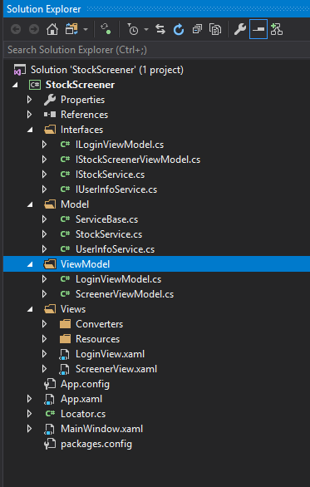
OUR SOLUTION
VIEW MODEL AND MODEL FOLDERS
CLASSES IN THOSE FOLDERS INHERIT THE CORRESPONDING INTERFACE AND NEED TO BE IMPLEMENTED
VIEW PERSON SHOULD UPDATE THE ILoginViewModel AND IStockScreenerViewModel INTERFACE
VIEW MODEL PERSON IMPLEMENTS THE LoginViewModel AND StockScreenerViewModel. ALSO UPDATES THE IStockService AND IUserInfoService INTERFACES
MODEL PERSON IMPLEMENTS THE StockService AND UserInfoService
STOCKSERVICE’S JOB IS TO GET THE STOCK QUOTES AND MANAGE THEM
USERINFOSERVICE’S JOB IS TO GET/UPDATE SETTINGS AND USER ACCOUNTS

Slide 9
IMPLEMENTATION IDEAS
Classes:
User – UserName, Settings, Watchlist
Settings – Screener selections (ranges for price etc.)
Stock – Stock symbol, latest price, % change from previous close, market cap, volume for today
Files:
UserSettings.xml: Xml serialization of a user class
StockMasterList.txt: List of all stock symbols we will ever see (Used by stock service to query through some api each stock we know of to get the info)
Open Questions:
Which API do we use to get stock quotes? Alphavantage looks promising.
Do we query all our stocks at start up (not sure how long that will take). Or do we keep a file with last known values and in the background always update that file (at least user sees something while its updating)
How are we splitting up the work?

